Slide 1
Intergea case study

Slide 2
The company
Holding company
10 Car dealer companies
each a single OEM with all their brands,
ex PSA with brands Peugeot, DS, Citroen; FCA with Fiat, Lancia, Jeep;
Insurance company
Car rental
115 locations , North and central Italy

Slide 3
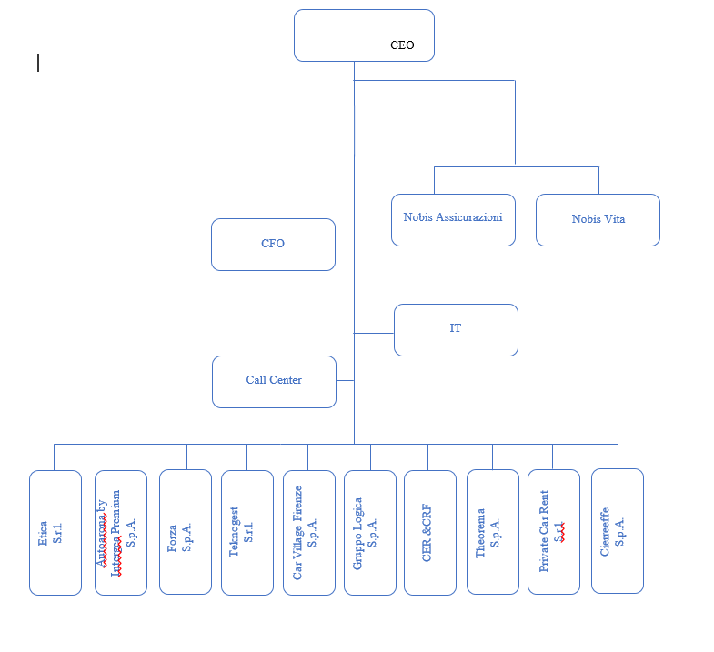

Slide 4
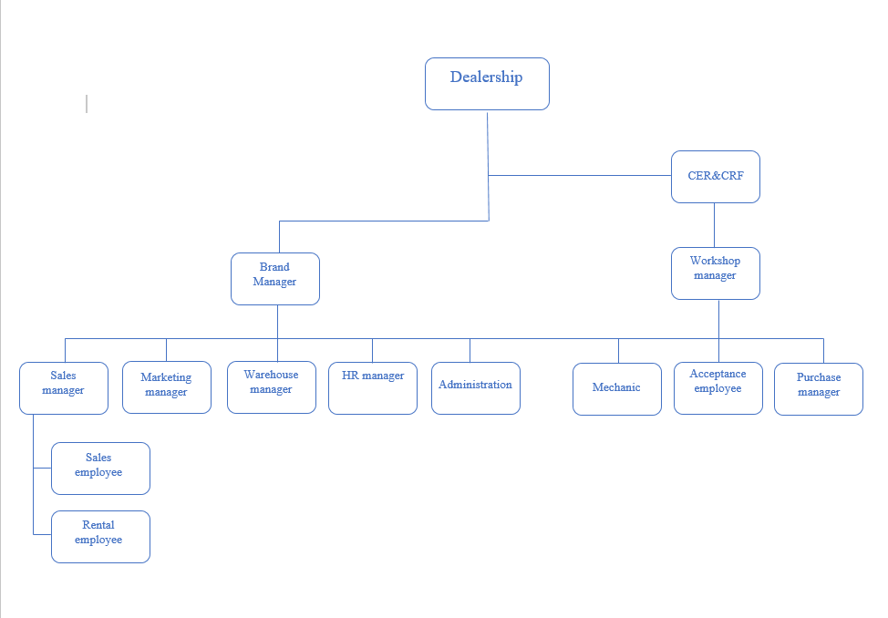

Slide 5
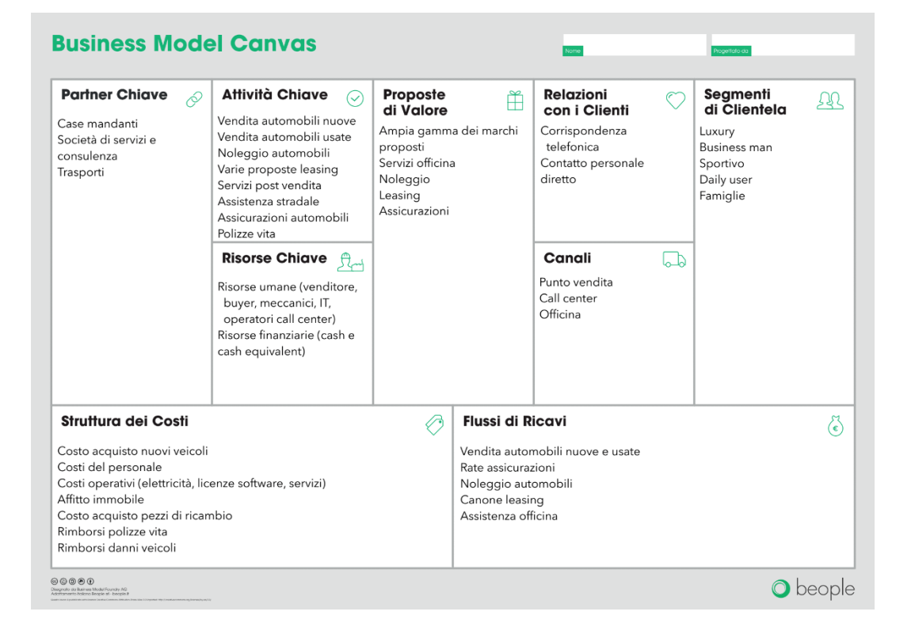

Slide 6
Key Processes
Sale of a new vehicle
Sale of a used vehicle
Purchase of a demo vehicle
Withdrawal of used vehicle
Maintenance / repair of vehicle
(insurance processes excluded)

Slide 7
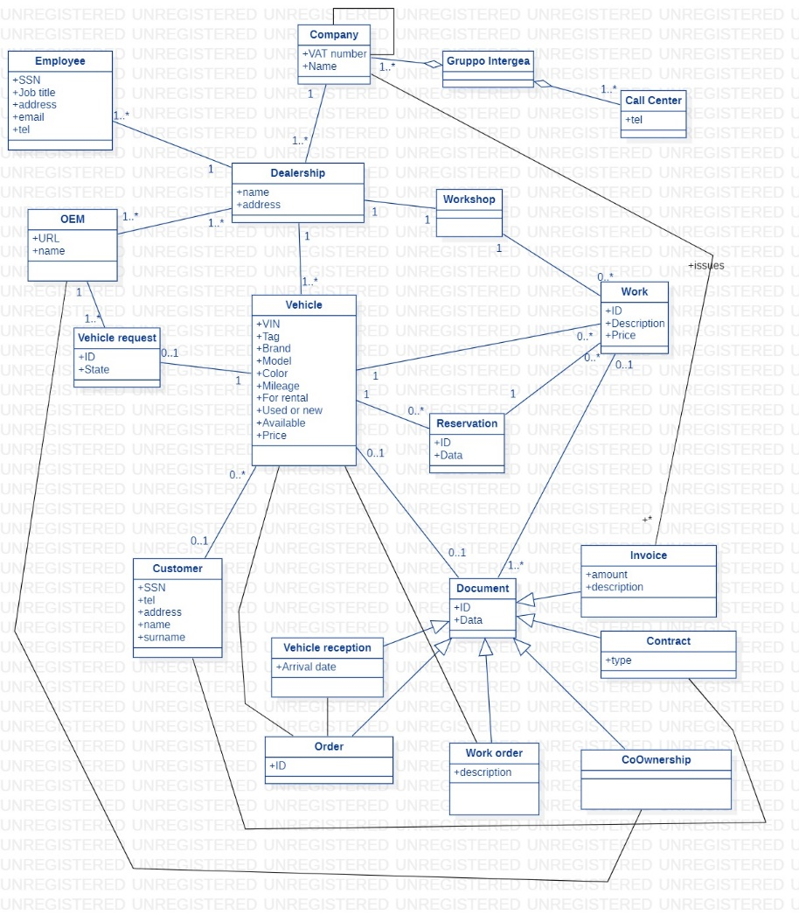
Conceptual model

Slide 8
Application portfolio
Name | Functions
Concerto | ERP, supports all processes (vehicle sale, rental, maintenance)
E | Accounting
ActiveInfo | Document archival
XLCubed | Business intelligence

Slide 9
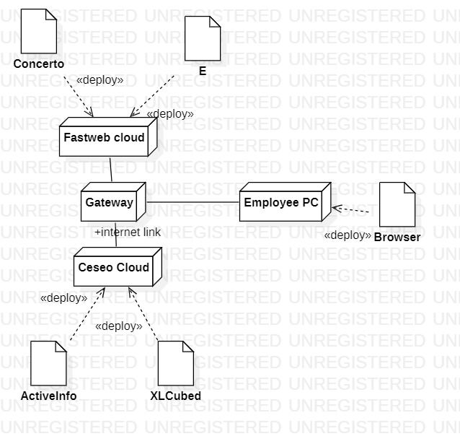
Deployment

Slide 10
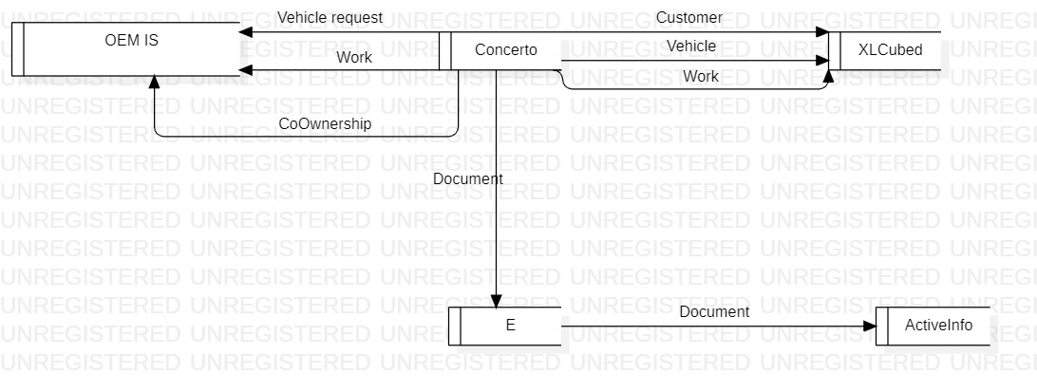
Data flow

Slide 11
As is - assessment
Key problem:
The ERP (Concerto) must interact with the OEM information system to exchange data about vehicles and customers
The OEM only accepts interaction with selected ERPs
Concerto is losing the approval by the OEMs
Data Intergea – OEM has to be entered manually

Slide 12
To be
Abandon Concerto, select another application
Constraints:
Support all processes (as Concerto)
Accepted by all OEMs
Possibly integrated with existing applications (E, XLCube)
Migration from Concerto data is possible
Options
Infinity by Visual Software
Sipad.X by Pentana Solutions

Slide 13
 | Functions |  | OEM certification
Infinity | Accounting Internal audit Sales and purchases Logistic, warehouse CRM (sales, after sales, car maintenance) E commerce and web portal HR (BI) (Document archival) | Can be interfaced with -E for accounting -ActiveInfo for document archival | Available for all OEMs
Sipad.X | Accounting Internal audit Sales and purchases Logistic, warehouse HR BI Document archival E commerce and web portal | Can NOT be interfaced with -E for accounting -ActiveInfo for document archival | Available for 90% OEMs

Slide 14
Infinity is the choice, mostly for the option of keeping ActiveInfo and E

